Slide 1

SHELTERSYNC AI
Team Name: Squad Busters
Email of Team Leader: sit22ec075@sairamtap.edu.in
UN Grand Challenge: {SDG 13: Climate Action}

Slide 2
Executive Summary
Climate disasters such as floods, cyclones, and heatwaves frequently expose gaps in evacuation coordination, leading to overcrowded shelters, delayed response, and inadequate protection for vulnerable populations. Our goal is to build an intelligent, district-level disaster response system that optimizes shelter allocation in real time, ensuring safe, equitable, and efficient evacuation management aligned with SDG 13 (Climate Action).
Our solution integrates geospatial hazard detection, machine learning-based disaster classification, real-time shelter occupancy tracking, and a multi-objective optimization engine into a centralized decision-support platform. Using GIS analysis and a Random Forest model, the system identifies high-risk zones and dynamically maps evacuees to the most suitable shelters. A constrained allocation algorithm ensures shelters operate below critical capacity thresholds while prioritizing elderly, disabled, and medically vulnerable individuals.
We developed a Python-based prototype using Geo Pandas, Shapely, scikit-learn, and pyomo to simulate hazard scenarios and optimize allocation decisions. The system also features an offline-first architecture with SMS fallback, ensuring operational continuity during connectivity disruptions.
Our business model targets district disaster management authorities through a government-licensing or SaaS framework, with scalable deployment from pilot districts to state-level integration.
What makes our solution novel is the integration of hazard intelligence, predictive forecasting, and mathematically enforced vulnerable-group prioritization within a privacy-by-design framework. The prototype demonstrates measurable improvements in allocation efficiency, occupancy stability, and coordination speed—proving both technical feasibility and real-world impact.

Slide 3
Goal
The goal of this project is to design a district-level intelligent shelter allocation system that ensures safe, equitable, and efficient evacuation during climate-related disasters such as floods, cyclones, and heatwaves.
Target Users
District Disaster Management Authorities
Revenue and municipal officials coordinating evacuations
Situations Where This Goal Matters
During sudden floods or cyclones, evacuees are often directed to the nearest shelter without visibility into real-time capacity, leading to overcrowding, long travel times, and unsafe conditions. In heatwaves, medically vulnerable individuals may not be prioritized for cooling shelters. Communication failures during power outages further delay coordination. In such high-pressure scenarios, decisions must be fast, data-driven, and fair.
Core Objective
To ensure that every evacuee is allocated to the most appropriate shelter based on distance, available capacity, facility compatibility, and vulnerability priority — while maintaining operational stability under disaster constraints.
Key Constraints
Limited and uneven shelter capacity
Infrastructure damage and road disruptions
Connectivity failures
Time-critical decision-making
Data privacy and security requirements
Success Criteria
Shelter occupancy maintained below critical thresholds (≤90%)
Reduced average evacuation allocation time
Guaranteed first-priority allocation for vulnerable groups
Real-time visibility of shelter status across the district

Slide 4
Idea
Our solution achieves the goal of efficient, equitable, and data-driven evacuation by transforming shelter management from manual coordination into an AI-assisted optimization system operating at the district level . The system is built around four integrated components.
First, a Geospatial Hazard Intelligence Module analyzes meteorological indicators such as rainfall intensity, river levels, wind speed, and heat index. Using GIS-based spatial overlay and a supervised learning model (Random Forest), it classifies disaster type and severity in real time. This allows authorities to identify high-risk zones early and estimate potential evacuation demand before conditions escalate.
Second, a Real-Time Shelter Monitoring System tracks shelter capacity, occupancy, medical facilities, food availability, and accessibility status through structured digital check-ins. An offline-first architecture with local data caching and SMS fallback ensures continuity during network or power disruptions—critical in disaster environments.
Third, the core innovation lies in a Constrained Multi-Objective Optimization Engine. Unlike static dashboards, our system actively computes optimal shelter allocation using hard constraints (e.g., occupancy capped at 90%, facility compatibility requirements) and weighted criteria such as travel distance, utilization balance, and vulnerability priority. Vulnerable populations—including elderly, disabled, and medically fragile individuals—are algorithmically prioritized, ensuring fairness through mathematical enforcement rather than manual discretion.
Fourth, a Predictive Forecasting Module uses short-term time-series analysis to anticipate occupancy saturation. This enables proactive redistribution alerts before overcrowding occurs, shifting the system from reactive to preventive response.
Feasibility is ensured through a Python-based architecture using Geo Pandas, Shapely, scikit-learn, and Pyomo—widely adopted, scalable, and cost-effective technologies. The system can integrate with existing district disaster databases and expand incrementally from pilot deployments.
Our unique value proposition lies in combining hazard prediction, real-time data ingestion, optimization-based allocation, predictive overcrowding prevention, and privacy-by-design governance into a single coordinated platform. This integrated approach ensures operational resilience, measurable performance improvement, and scalable implementation across districts facing increasing climate risks.

Slide 5
Prototype or Proof-of-Concept (1/2)
Novelty
Integrates hazard prediction, real-time shelter tracking, optimization-based allocation, and forecasting into one unified district-level platform.
Enforces vulnerable-group prioritization mathematically through constrained optimization, not manual decision-making.
Hazard Detection Module
ML-based disaster type and severity classification.
Early risk alerts using real-time meteorological data.
Geospatial Mapping Layer
GIS-based impact zone and shelter mapping.
Optimal route calculation for safe evacuation.
Real-Time Shelter Allocation Engine
Constrained optimization(<=90% Capacity rule).
Vulnerable-priority, distance-aware allocation.
Predictive Overcrowding Forecast
Short-term occupancy prediction.
Pre-emptive saturation alerts.
Feasibility
Built using proven, scalable Python technologies (Geo Pandas, scikit-learn).
Compatible with existing district disaster management databases and workflows.
Modular architecture allows phased pilot deployment and gradual scaling.
We developed a Python-based simulation prototype integrating hazard classification, GIS routing, and constrained multi-objective optimization for shelter allocation. The system processes simulated disaster and occupancy data to generate optimal, vulnerability-aware shelter assignments. Results demonstrate improved allocation balance, reduced overcrowding risk, and faster decision response.

Slide 6
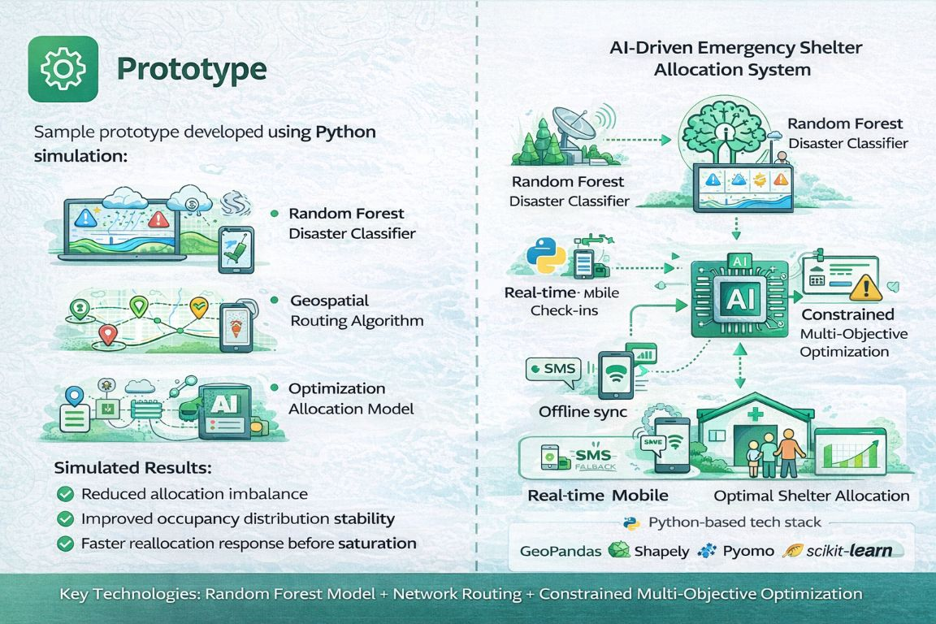
Prototype or Proof-of-Concept (2/2)

Slide 7
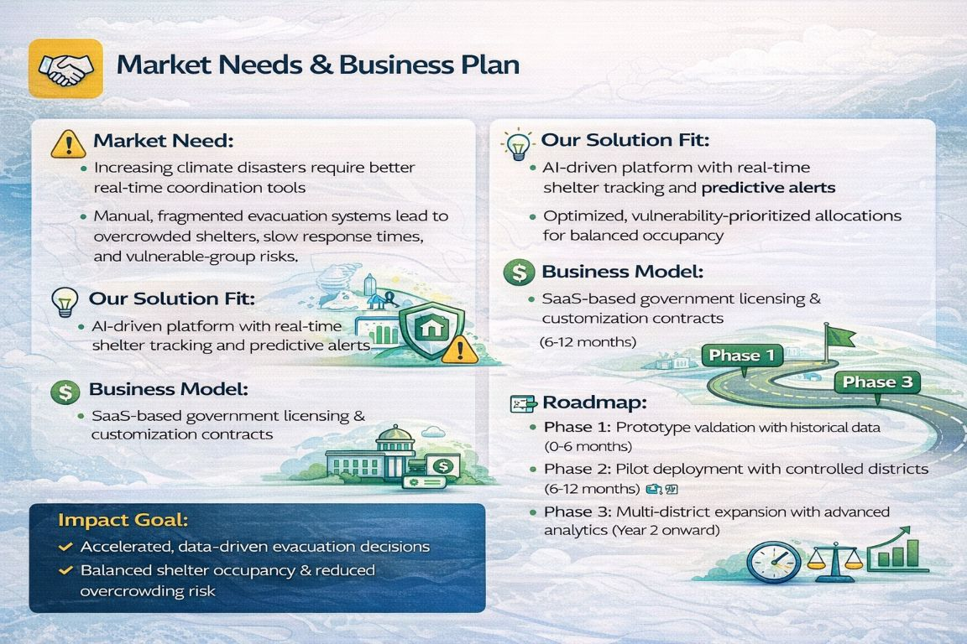
Market Needs & Business Plan
Market Need:
District authorities face increasing climate disasters with limited real-time coordination tools. Current evacuation systems are manual, fragmented, and reactive, leading to overcrowded shelters, delayed allocation, and poor visibility of vulnerable populations.
Our Solution Fit:
An AI-driven, district-level evacuation optimization platform that enables real-time shelter tracking, predictive overcrowding alerts, and vulnerability-prioritized allocation.
Business Model:
Government-focused SaaS subscription model with annual district licensing, customization, and maintenance support contracts.
Feasibility & Scalability:
Cloud-based architecture, low hardware requirements (mobile check-ins), and modular integration ensure cost-effective scaling across districts.
Impact Goal:
Faster evacuation decisions, balanced shelter occupancy, and measurable improvement in disaster response efficiency.

Slide 8
Research and Literature Review
What Is Known
Optimization models improve shelter allocation efficiency under capacity constraints. Machine Learning supports hazard prediction and evacuation forecasting. GIS-based spatial analysis enhances disaster impact mapping and route planning.
What Is Missing
Lack of integrated systems combining hazard detection, allocation, and forecasting. Reactive shelter management without predictive overcrowding prevention. Limited enforcement of vulnerable-group prioritization. Poor resilience to connectivity and power disruptions.
Our Contribution
Unified AI platform integrating prediction + optimization + real-time tracking. Proactive overcrowding alerts using time-series forecasting .Mathematically enforced vulnerability-based allocation. Offline-first, disaster-resilient system design.

Slide 9
Competition + Next Steps
Alternatives in the Market
Traditional Evacuation Systems: Manual coordination, static shelter lists, reactive decision-making.
Early Warning Apps: Provide hazard alerts but no shelter allocation or optimization.
Basic Shelter Dashboards (NGOs): Track capacity but lack AI forecasting and district-wide integration.
Our Key Advantage
Integrated platform:
Hazard detection + real-time shelter tracking + AI allocation.
Predictive overcrowding forecast before shelters reach critical levels.
Vulnerability-prioritized routing with offline/SMS backup support.
Revenue & Sustainability Model
SaaS-based licensing for government bodies.
Customization & integration contracts at district/state level.
Long-term maintenance & analytics subscription model.
Next Steps to Outperform
Pilot deployment with government disaster authority.
Integrate IoT-based occupancy sensors for accurate live data.
Publish validation results & scale through state-level partnerships.

Slide 10

References
Chang, J., et al. “Shelter location–allocation problem for disaster evacuation planning: A simulation optimization approach.”Computers & Operations Research, 171 (2024).
— Presents two-stage stochastic optimization for shelter location and allocation, highlighting advanced operational research techniques for disaster response planning.
Yin, Y., Zhao, X., and L v, W. “Emergency shelter allocation planning technology for large-scale evacuation based on quantum genetic algorithm.”Frontiers in Public Health (2023).
— Uses evolutionary algorithms for large-scale shelter allocation planning, demonstrating optimization under complex constraints in emergency contexts.
Lei He & Zi ang Xie. “Optimization of Urban Shelter Locations Using Bi-Level Multi-Objective Location-Allocation Model.”Int J Environ Res Public Health (2022).
— Introduces a bi-level multi-objective allocation framework considering accessibility, economy, and efficiency, providing grounding for advanced allocation models.
IEEE cases:“Intelligent Shelter Allotment for Emergency Evacuation Planning: A Case Study of Makkah.” (IEEE Xplore).
— A region-specific study on intelligent evacuation and shelter distribution using technology-assisted planning methods.
Li, B., Liu, C., & Mostafavi, A. Evac-Cast: Interpretable ML for evacuation forecasts across hurricanes and wildfires. (2025).
— Shows ML models predicting evacuation behavior as support tools in emergency planning.
Sun, W., Bocchini, P., & Davison, B. “Applications of AI for Disaster Management.”Natural Hazards (2020).
— Comprehensive review of AI’s role across disaster response phases, including prediction and decision support.
Jain, H., et al. “Leveraging machine learning algorithms for improved disaster preparedness and response.”Frontiers in Environmental Science (2023).
— Discusses advanced ML for forecasting weather extremes and disaster scenarios.

Slide 11
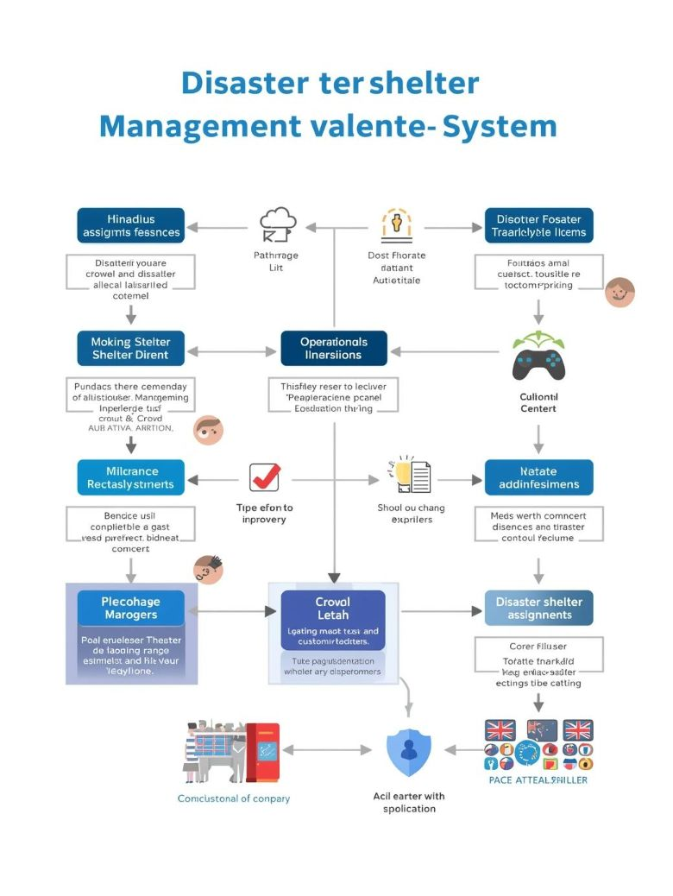

Slide 12
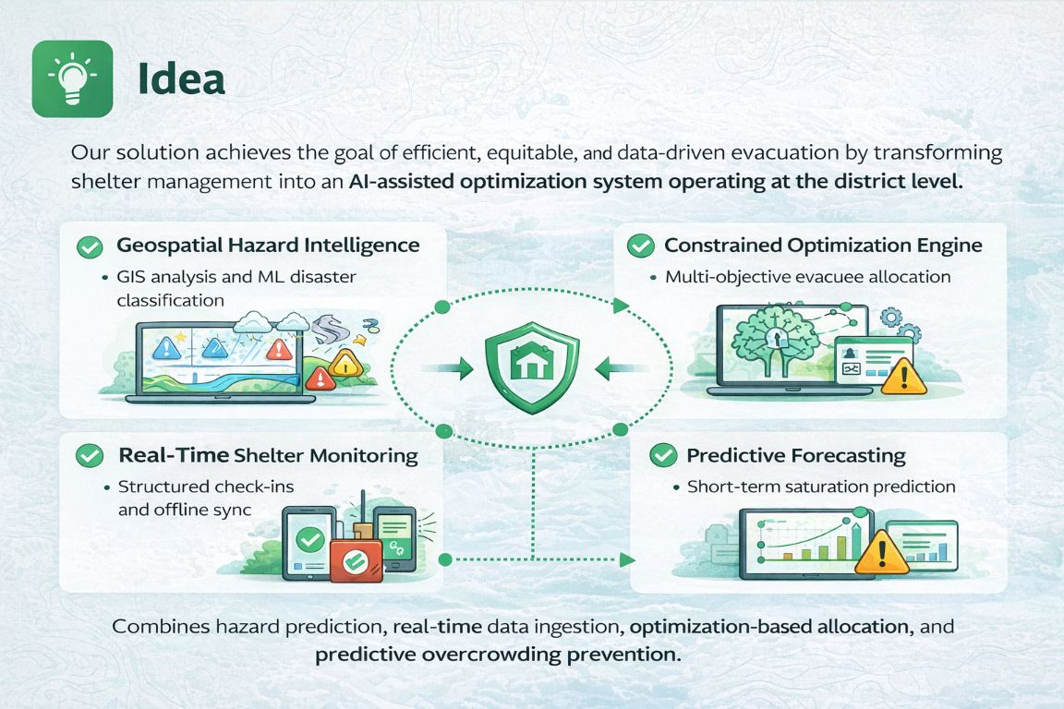
IDEATION

Slide 13
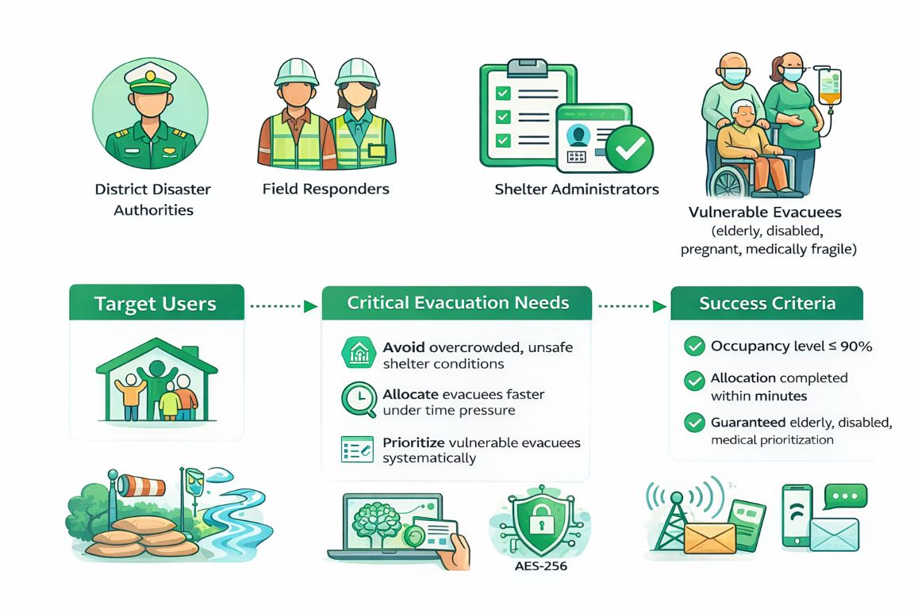
WORKFLOW

Slide 14
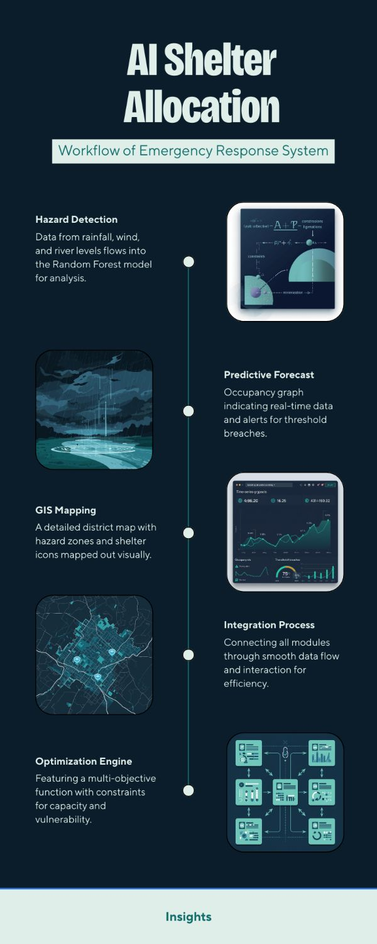
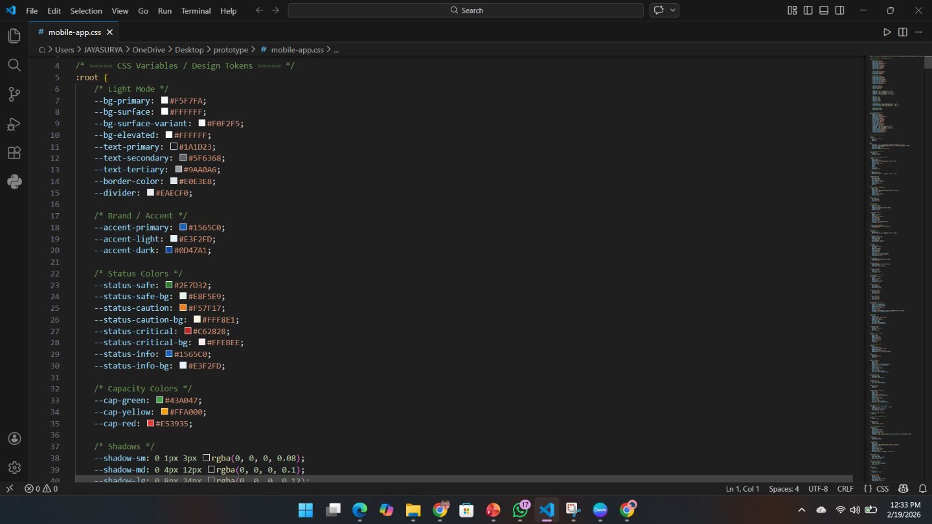
CODESPACE

Slide 15
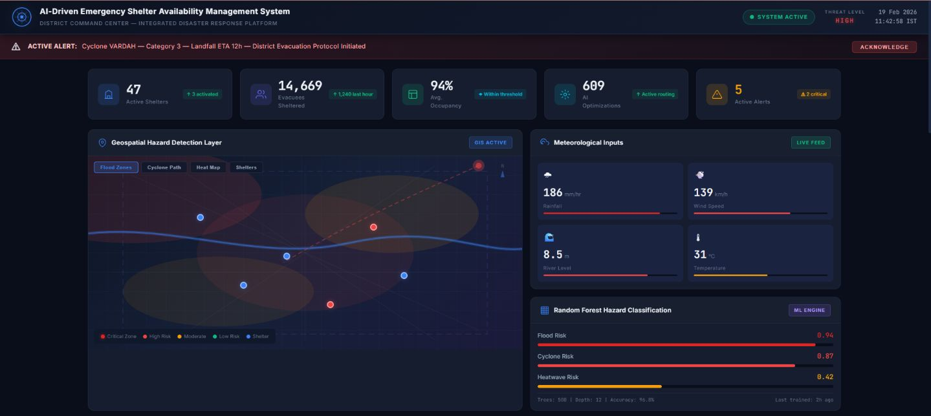
WEB FRAMEWORK

Slide 16
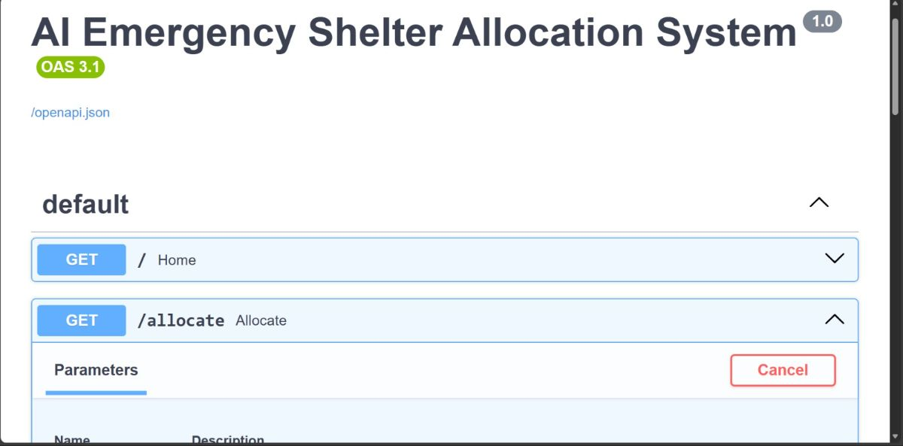
APPENDIX E
BACKEND

Slide 17
